Slide 1




Slide 2
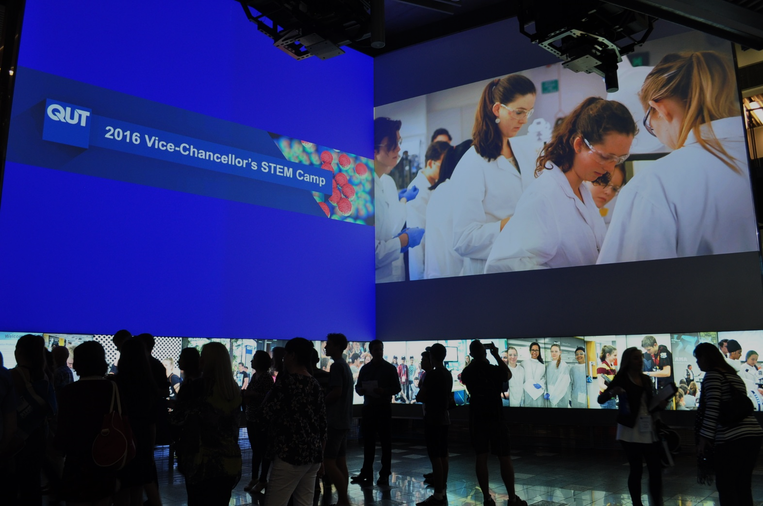
VICE-CHANCELLOR’S STEM CAMP
Vice-Chancellor’s STEM Camp for High-Achieving Year 11 students
First camp in 2013
Showcase for QUT’s Science, Technology, Engineering and Mathematics disciplines
Students apply to attend their project of choice
Projects cover a broad range of disciplines
Fully funded by QUT (no cost to students or schools)

Slide 3
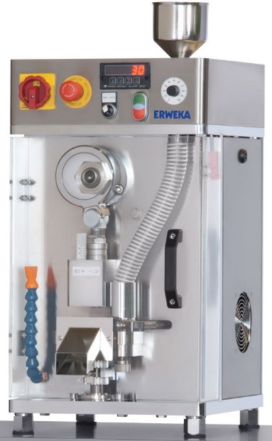
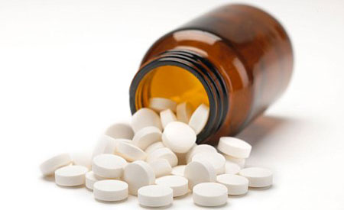
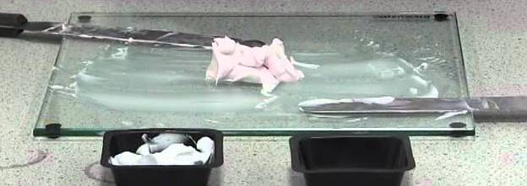
2013-2015
Encapsulating Precision
Original Pharmacy project
Tasks covering a wide range of Pharmacy disciplines including:
  Tablet Manufacturing
  Quality Control
  Capsuling
  Compounding
  Dispensing

Slide 4
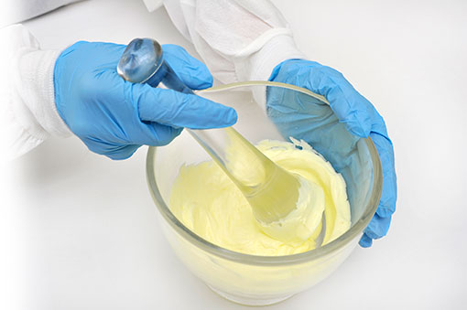
Tasks:
Tablet Manufacturing – students make Ibuprofen tablets from raw materials
Tablet QC – students test their tablets using British Pharmacopoeia standard tests: Content Uniformity; Hardness; Friability, Disintegration, Dissolution
Compounding – students make lipbalms, creams, capsules and suppositories using fake scripts.

Slide 5
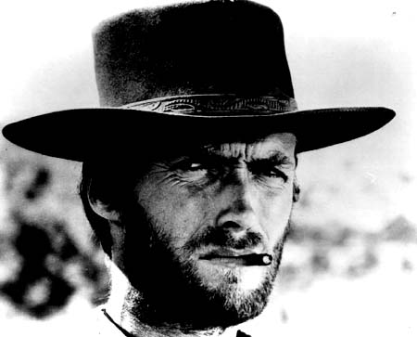

The Good
The Bad
Covers a wide range of practical Pharmacy work
Excellent overview of Pharmacy
Very hands on
Bland – a series of practical tasks lifted from various undergrad Pharmacy practicals
Lack of engagement
No theme beyond “Pharmacy”

Slide 6

HOW CAN WE MAKE IT MORE ENGAGING?

Slide 7


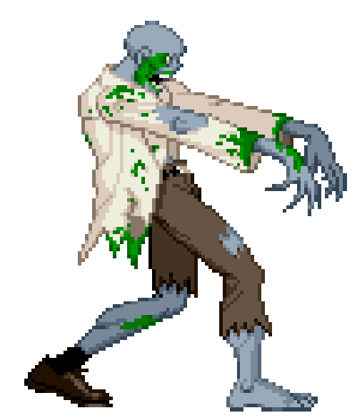
ENTER THE YASMIN!
Dr Yasmin Antwertinger – Associate Lecturer in Pharmacy
Her idea: link the tasks with a contemporary theme:

Slide 8

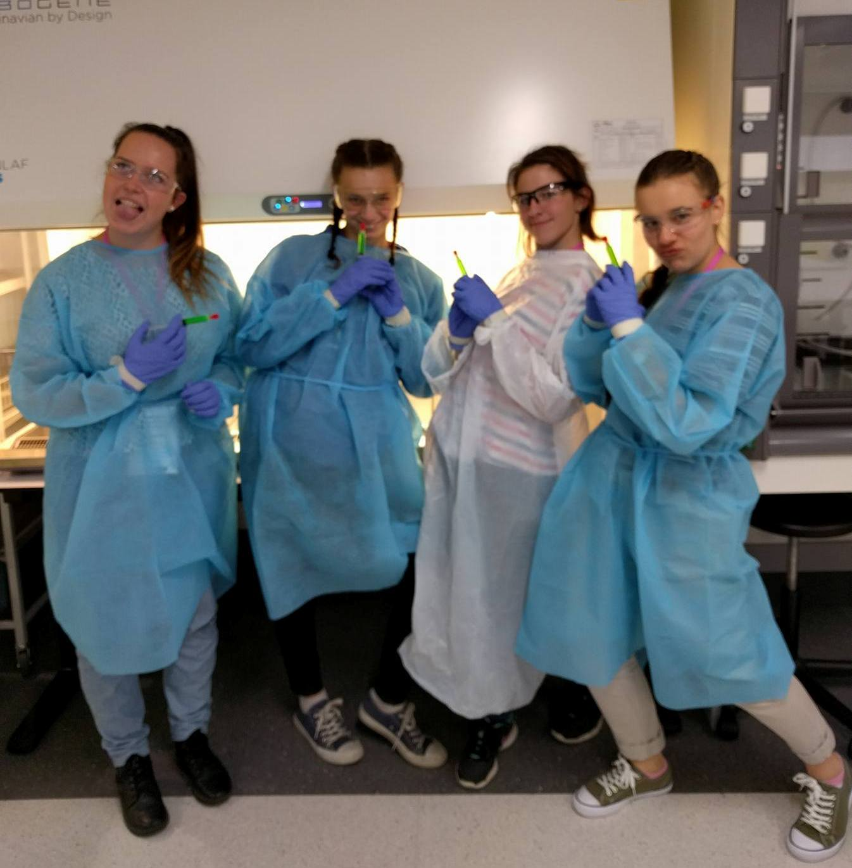
Students form a task force to combat the “Z0-M8-13” virus
Mission Objectives:
  Determine effective delivery vectors for “Zombavir” drug
      Intravenous
      Oral
  Identify and manufacture effective “zombie repellant” for first-responders
  Identify suitable topical treatment for bite victims

Slide 9
Task 1: Identifying & Classifying Victims
Teams test a simple colour dependant reaction to test victims and classify them.
The teams are informed that the experimental drug was observed to induce paralysis in non-infected individuals, but showed a 95% recovery rate for infected individuals. Testing is essential to prevent side effects!
“The samples of patients who are positive for the Z0-M8-13 virus will turn blue/black when mixed with the test reagent. You must time the appearance of when the blue/black colour appears. The blue/black colour will appear more rapidly in patients who have been exposed for a longer period of time.
  “The tests where the blue/black colour appears within 1 minute, these patients have anywhere between 15 mins to 5 hours before the symptoms kick in.
  “The tests where the blue/black colour appears between 1 to 10 minutes, these patients have between 5 hours to 3 days before the symptoms kick in.”

Slide 10
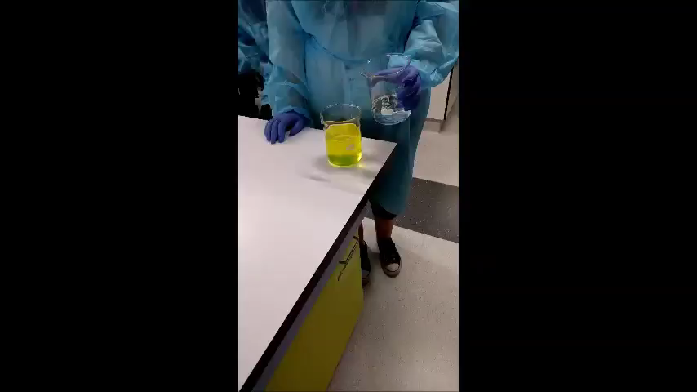
A simple Iodine Clock reaction.
Two reagents, one of which is labelled as “Patient Sample”.
Sodium Thiosulphate concentration is adjusted to vary the colour change delay. More thiosulphate = longer delay = less critical “patient”.

Slide 11
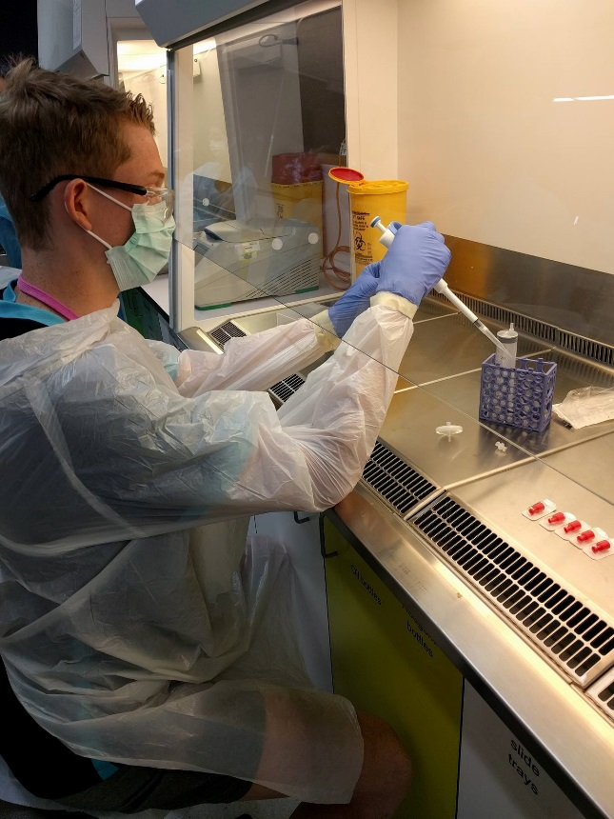
Task 2: Develop a Rapid Response Treatment
Teams develop a treatment for rapid administration and absorption
Students manufacture an intravenous “drug” under aseptic conditions
Master Formula:
*qs: quantum satis
 | Purpose / function of ingredient | Master formula | Calculation for 50 mL
Zombavir |  | 5%
Benzyl alcohol stock |  | 2%
Sodium chloride solution |  | 3%
Citric acid solution |  | 6%
Sterile-pyrogen free water for injection |  | qs* to 10 mL

Slide 12
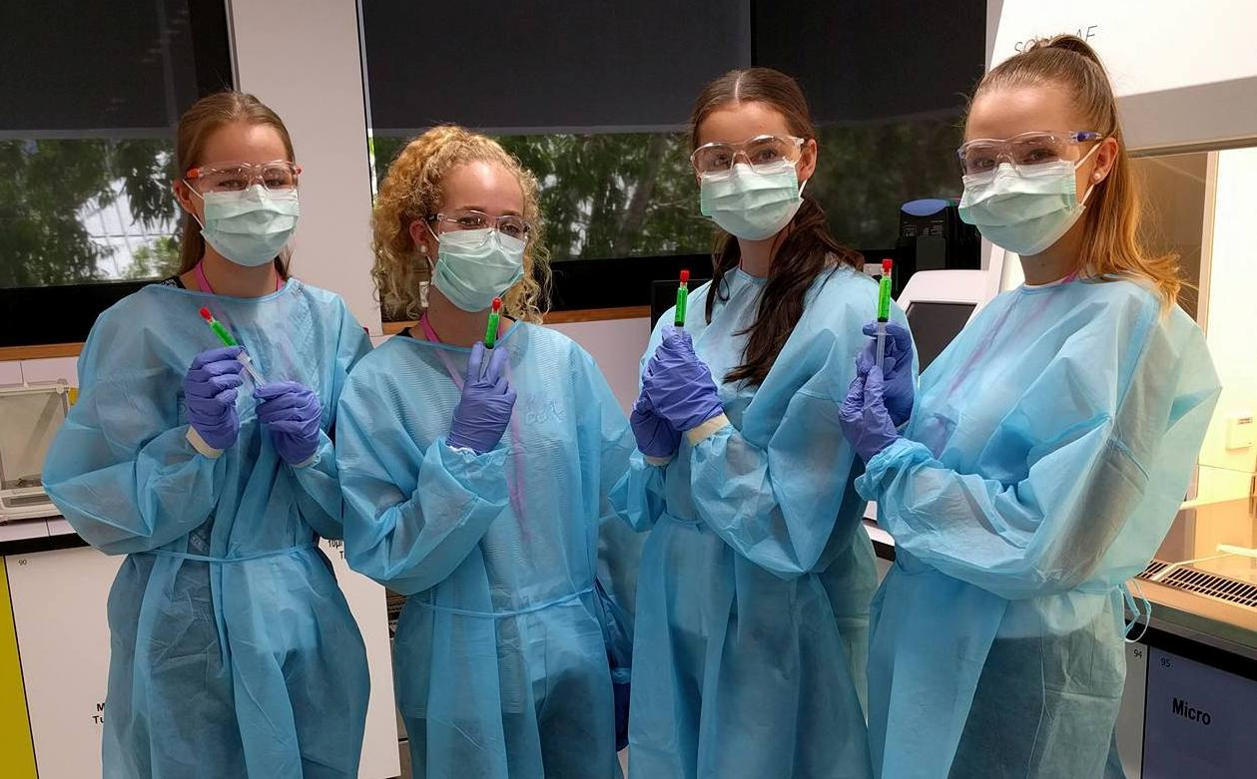
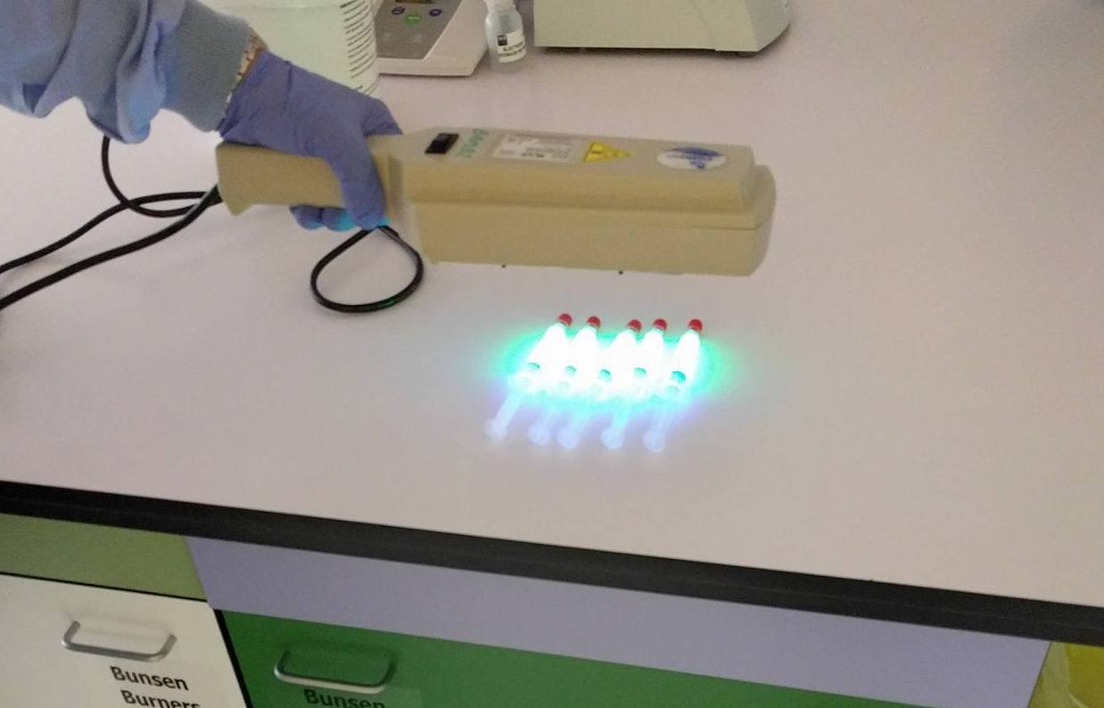
Students are gowned and gloved as per aseptic requirements and work in laminar flow hoods
Final “injections” are sterile filtered and bagged.
“Zombavir” active ingredient: Green Highlighter Ink! It fluoresces under UV light, looks the part and is cheap and non-toxic.
Students can “test” their sample by subjecting it to UV.

Slide 13
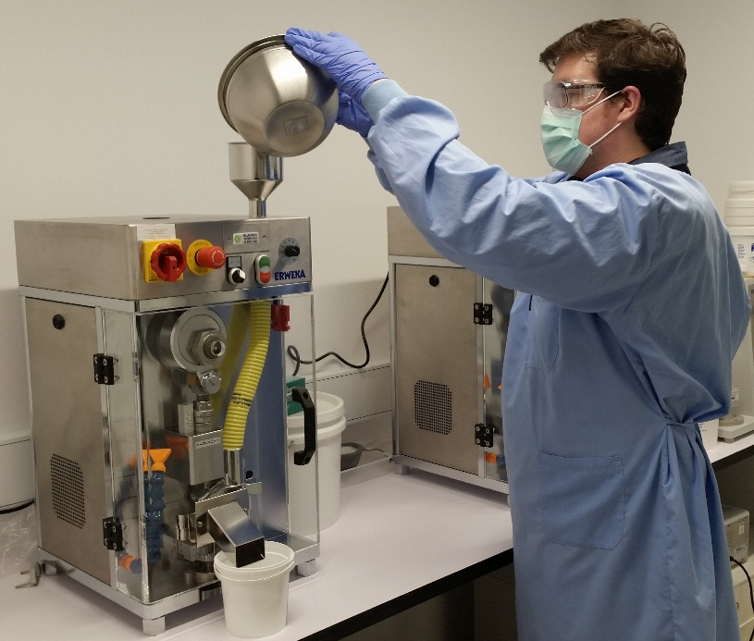
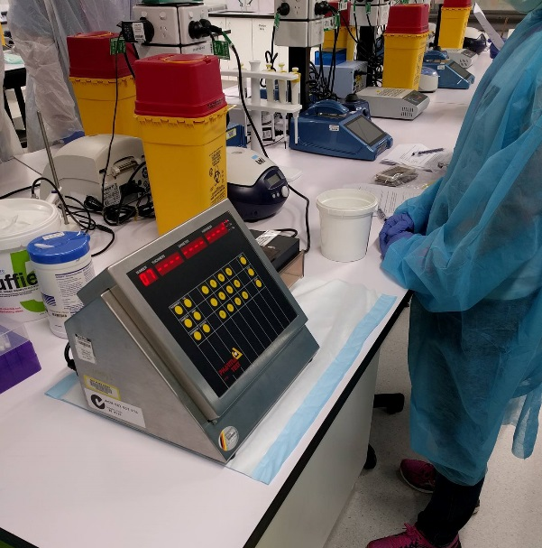
Task 3: Develop a Mass Market Treatment
Teams develop a mass-produced oral form of “Zombavir”
Students manufacture tablets and subject them to Quality Assurance testing according to British Pharmacopoeia guidelines.

Slide 14
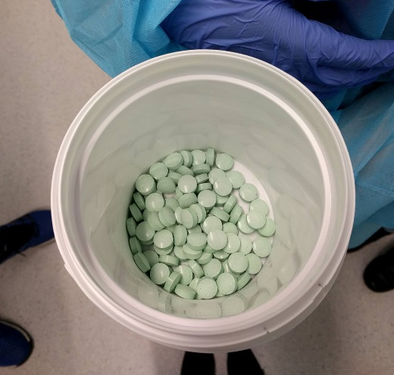
Recycle old Tablet Manufacturing & QC practical
“Zombavir” = Ibuprofen as active ingredient – relatively inexpensive, easy to assay, suitable for direct compression formulation.
Coloured Ibuprofen with green food colouring to match liquid “Zombavir” (extensively tested to ensure no interference with student results)
Master Formula
 | Purpose of ingredient | Formula for ONE (1) tablet | Calculation for 100 tablets
Zombavir |  | 200 mg
VIVAPUR® (microcrystalline cellulose) |  | 300 mg
Lactose monohydrate, Spray-dried |  | 242 mg
EXPLOTAB® (sodium starch glycolate) |  | 8 mg
Magnesium stearate |  | 8 mg
Colloidal silica |  | 4 mg

Slide 15
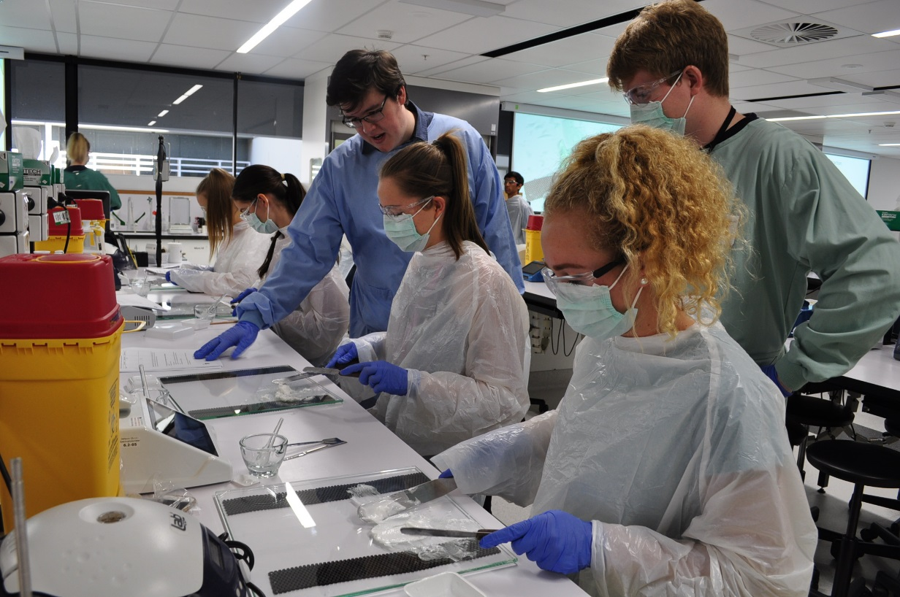
Task 4: Produce a “Zombie Repellant”
Teams are tasked to produce a “Zombie Repellant” to protect healthcare workers and front-line personnel from attack.
Students compound a “repellent cream” from the very pungent “Zombavox”
Menthol in Sorbolene cream produces a very pungent smelling product

Slide 16
Students work from a “script” and use batch recording to simulate a true compounding experience.

Slide 17
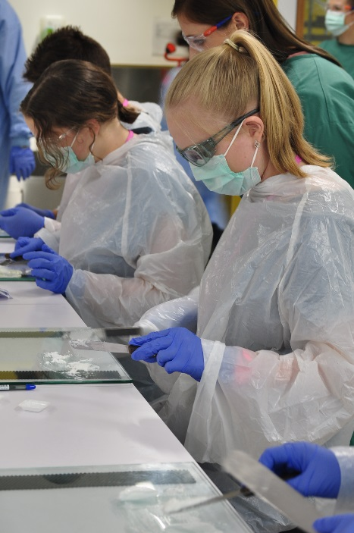
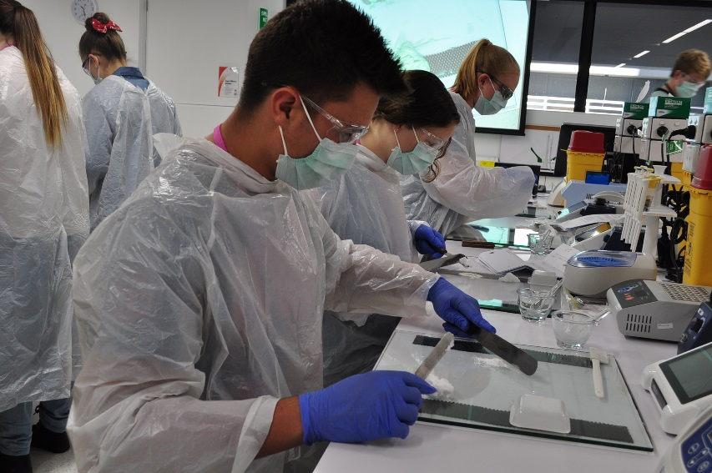
Task 5: Formulate a Topical Treatment
Teams are tasked with determining the correct vehicle for two potential topical drugs for treatment of bites
Students compound two drugs into different cream bases to see the effects of incompatible substances
Teams then decided which will be the most suitable drug to use for manufacturing

Slide 18
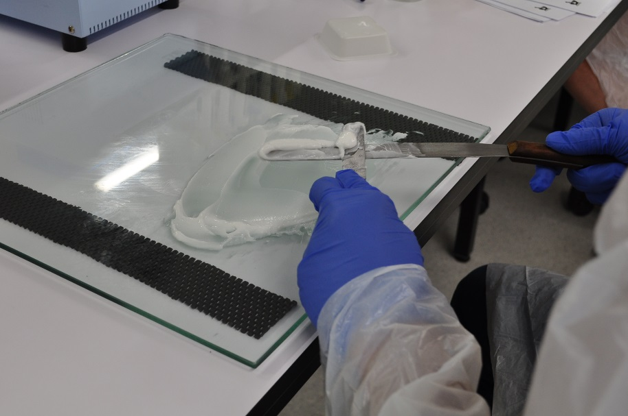
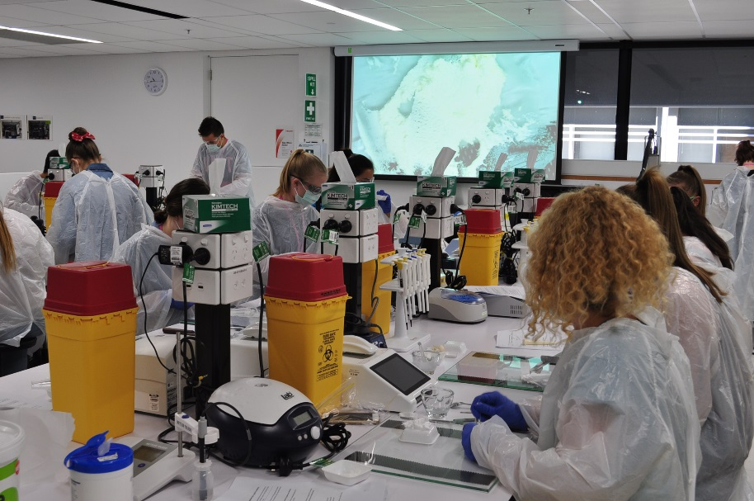
Students compare Resorcinol to Sulfacetamide in Sorbolene, Aqueous and Cetrimide cream bases
Observe the effects each drug has on each vehicle
Resorcinol breaks down emulsifying agents in many creams, causing them to “crack”
Small test samples (~20g each) keeps costs down while still providing the required results

Slide 19
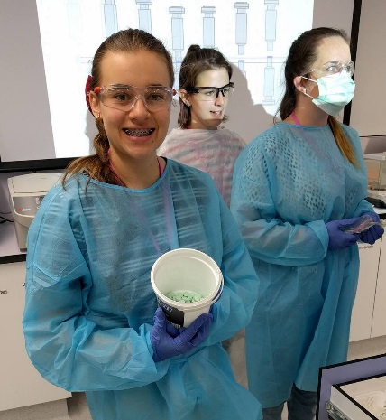
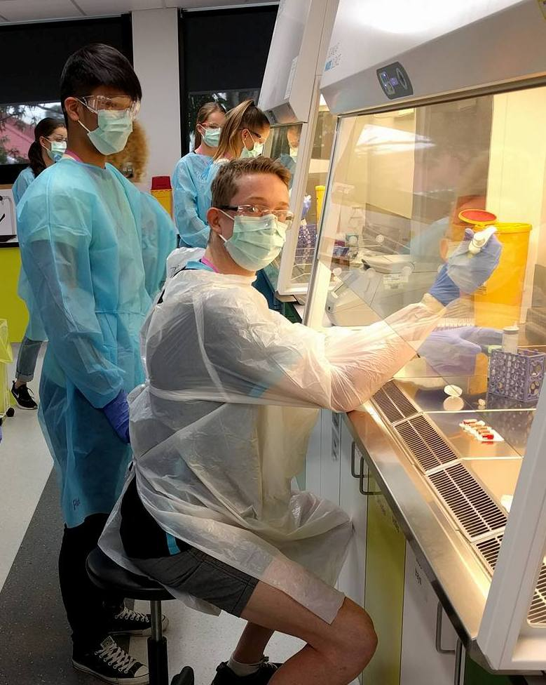
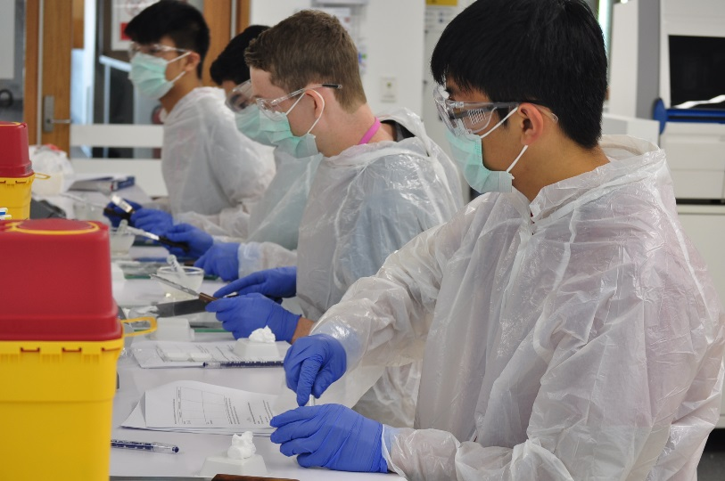
Results:
A more immersive experience
Tasks linked with a theme gives more meaning to the project
Still showcases what students can expect in the QUT Pharmacy course

Slide 20
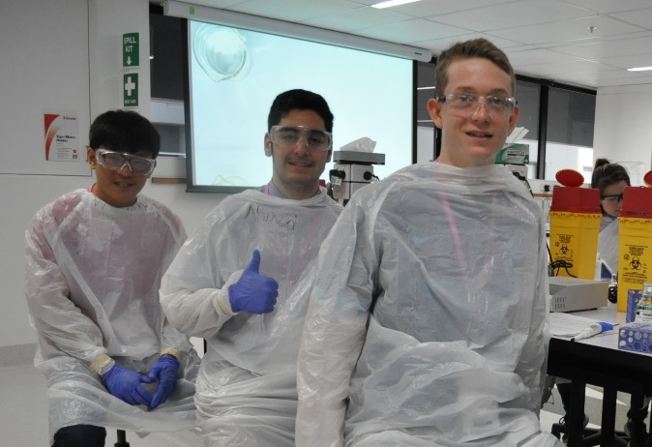
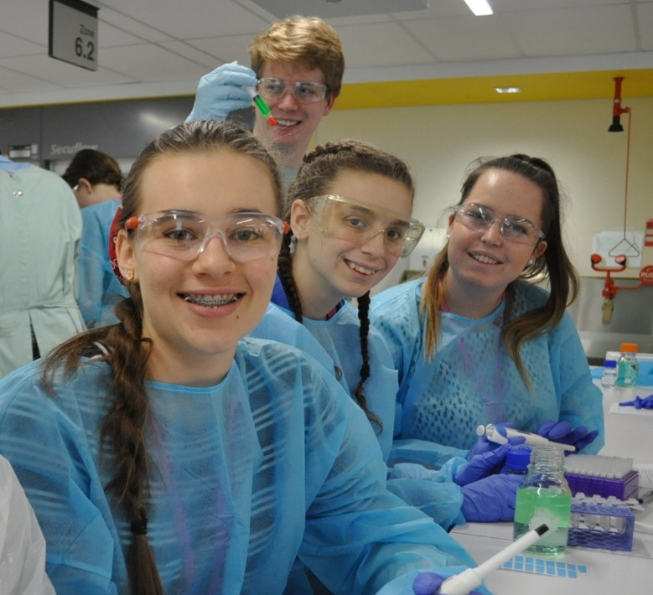
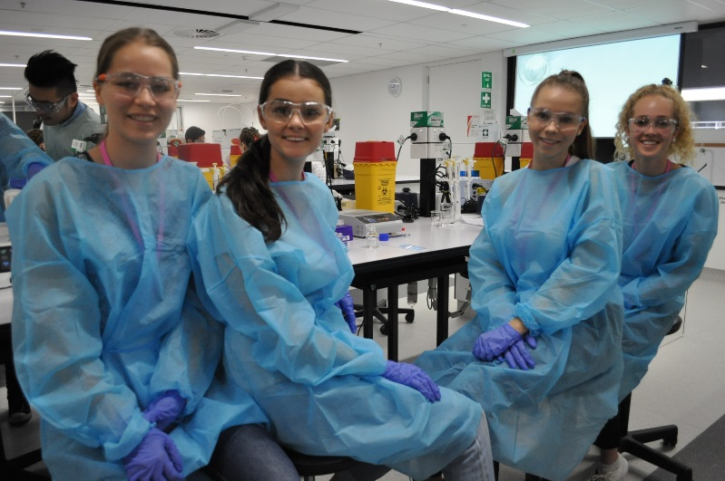
But most of all:
IT’S FUN!!

Slide 21
To the Future!
Discussions have already begun on ways to improve the experience for 2017
  Include a capsuling task: maybe compare pros and cons of tablets to capsules
  Produce a briefing video to help set the scene

Slide 22
Thanks to:
Mr Jacob McAloney (Laboratory Assistant, Pharmacy; QUT)
Dr Yasmin Antwertinger (Associate Lecturer, Pharmacy; QUT)
Ms Tanya Rinas (Laboratory Assistant, Pharmacy; QUT)
Ms Rachel Bilsborough (Marketing and Communication, STEM for Schools Program; QUT)
Ms Meghann Avery (Student Ambassador; QUT)
Mr James Hounslow (Student Ambassador; QUT)
Ms Kaitlyn Porter (PhD Student, Pharmacy; QUT)
Mr Simon Wong (PhD Student, Pharmacy; QUT)
Dr Esther Lau (Lecturer, Pharmacy; QUT)
The STEM for Schools Team @ QUT

